Slide 1
11/03/24

Slide 2
Processional

Slide 3
Lighting of Candles
Greetings

Slide 4
Call to Worship…
LEADER: What do you bring before the Lord this day?
People: We bring our hopes and our dreams to the Lord.

Slide 5
LEADER: What do you seek?
People: We seek peace for our weary souls.

Slide 6
LEADER: You will find it in this place, for this is the house of the Lord.
People: Open our hearts and our spirits, O Lord, to hear your words of comfort and peace.

Slide 7
ALL: AMEN

Slide 8
Opening Selection Wesley’s Ensemble

Slide 9
Morning Prayer

Slide 10
Response

Slide 11
Affirmation of Faith

Slide 12
I believe in God the Father Almighty. The maker of heaven and earth;

Slide 13
and in Jesus Christ his only Son our Lord: who was conceived by the Holy Spirit, born of the Virgin Mary,

Slide 14
suffered under Pontius Pilate, was crucified, dead, and buried;

Slide 15
the third day he rose from the dead; he ascended into heaven,

Slide 16
and sitteth at the right hand of God the Father Almighty; from thence he shall come to judge the quick and the dead.

Slide 17
I believe in the Holy Spirit, the Holy catholic** church, the communion of saints, the forgiveness of sins,
**Church Universal

Slide 18
the resurrection of the body, and the life everlasting. Amen.

Slide 19
Glory be to the Father, and to the Son and to the Holy Ghost,

Slide 20
as it was in the beginning, is now, and ever shall be, world with-out end.
A-men. A-men

Slide 21
The Offering (It’s Giving Time) (Offering Baskets will not be passed. Please leave your tithes and offerings in the back of the Sanctuary when entering or leaving.)

Slide 22
*The Dedication
of
Tithes and Offering
UMH #588 “All things come of thee, O Lord, and of thine own have we given thee.” AMEN!

Slide 23
Church News & Announcements

Slide 24
WE Listen for God’s Word

Slide 25
Proclamation and Response/We Listen for God’s Word
Old Testament: Isaiah 25: 6-9
New Testament: Revelation 21: 1-6a
Leader: The Word of God for the people of God.
People: Thanks be to God

Slide 26
Selection Wesley’s Ensemble

Slide 27
The Message by
“What kind of Saint are you?”
Reverend Doris R. Bright, Pastor

Slide 28
Invitational /
Altar Call

Slide 29
Extinguishing of the Candles

Slide 30
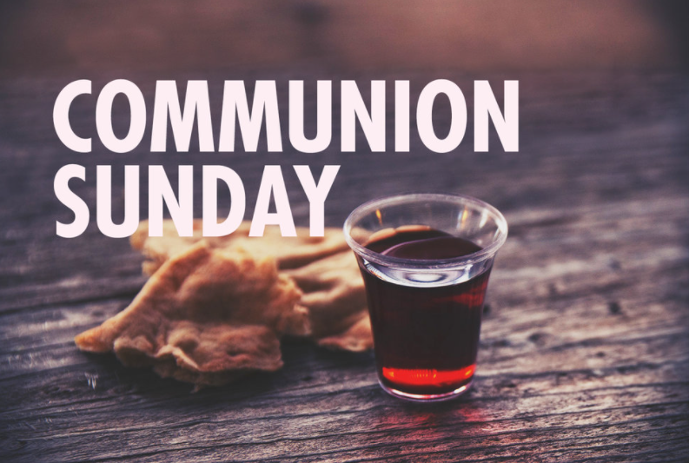

Slide 31
INVITATION
Christ our Lord invites to his table all who love him, who earnestly repent of their sin
and seek to live in peace with one another.
Therefore, let us confess our sin before God and one another.

Slide 32
CONFESSION AND PARDON
Merciful God,
We confess that we have not loved you with our whole heart.
We have failed to be an obedient church.

Slide 33
We have not done your will,
We have broken your law,
We have rebelled against your love,
we have not loved our neighbors,
and we have not heard the cry of the needy.

Slide 34
Forgive us, we pray.
Free us for joyful obedience,
through Jesus Christ our Lord. Amen.

Slide 35
Leader to people:
Here the good news:
Christ died for us while we were yet sinners; that proves God’s love toward us.
In the name of Jesus Christ, you are forgiven!

Slide 36
People to leader:
In the name of Jesus Christ, you are forgiven!

Slide 37
Leader to people:
Glory to God. Amen

Slide 38
TAKING THE BREAD AND CUP
THE GREAT THANKSGIVING
The Lord be with you.
And also with you.
Lift up your hearts.
We lift them up to the Lord.

Slide 39
Let us give thanks to the Lord our God.
It is right to give our thanks and praise.

Slide 40
It is right, and a good and joyful thing, always and everywhere to give thanks to you, Father Almighty, creator of heaven and earth.*

Slide 41
And so,
with your people on earth and all the company of heaven we praise your name and join their unending hymn:

Slide 42
Holy, holy, holy Lord, God of power and might, heaven and earth are full of your glory. Hosanna in the highest. Blessed is he who comes in the name of the Lord. Hosanna in the highest.

Slide 43
Holy are you, and blessed is your Son Jesus Christ.* By the baptism of his suffering, death, and resurrection you give birth to your church,

Slide 44
delivered us from slavery to sin and death, and made with us a new covenant by water and the Spirit.*

Slide 45
On the night in which he gave himself up for us he took bread, gave thanks to you, broke the bread, gave it to his disciples, and said:

Slide 46
“Take, eat; this is my body which is given for you.
Do this in remembrance of me.”

Slide 47
When the supper was over, he took the cup, gave thanks to you, gave it to his disciples, and said:

Slide 48
“Drink from this, all of you;
this is my blood of the new covenant, poured out for you and for many for the forgiveness of sins.

Slide 49
Do this, as often as your drink it, in remembrance of me.”

Slide 50
And so,
In remembrance of these your mighty acts in Jesus Christ, we offer ourselves in praise and thanksgiving as a holy and living sacrifice,

Slide 51
in union with Christ’s offering for us, as we proclaim the mystery of faith.

Slide 52
Christ has died; Christ is risen; Christ will come again.

Slide 53
Pour out your Holy Spirit on us gathered here, and on these gifts of bread and wine.

Slide 54
Make them be for us the body and blood of Christ, that we may be for the world the body of Christ, redeemed by his blood.”*

Slide 55
By your Spirit make us one with Christ, one with each other, and one in ministry to all the world, until Christ comes in final victory, and we feast at his heavenly banquet.

Slide 56
Through your Son Jesus Christ, with the Holy Spirit in your holy church, all honor and glory is yours, almighty Father, now and for ever. AMEN

Slide 57
And now, with the confidence of children of God, let us pray:
THE LORD’S PRAYER

Slide 58
BREAKING THE BREAD
GIVING THE BREAD AND CUP
The body of Christ, given for you. Amen
The blood of Christ, given for you. Amen

Slide 59
HYMN OR SONG
DISMISSAL WITH BLESSING
Go forth in peace.
The grace of the Lord Jesus Christ,
And the love of God, and the communion of the Holy Spirit be with you all. Amen

Slide 60
Song of
Sending Forth

