Slide 2
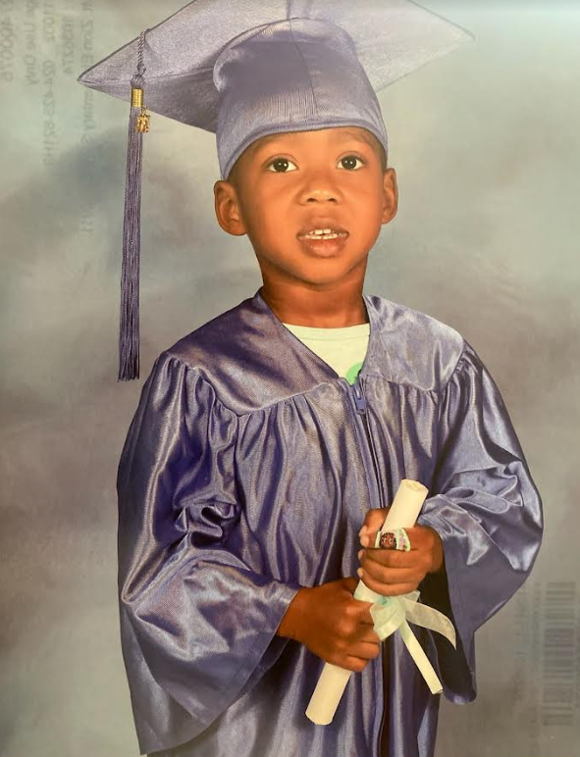
Sincere Anderson
(Son of DaNikqua Anderson)
Sincere will be going to
Child Development at
Mt. Zion Elementary School

Slide 3
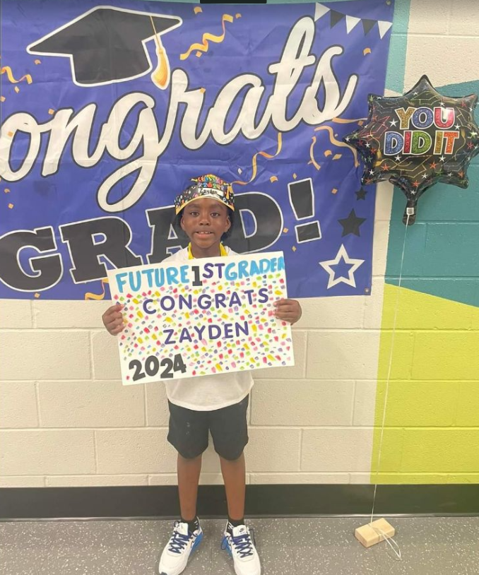
Zayden Anderson
(Son of Dezja Anderson)
Zayden will be going to the
1st Grade at
Stono Park Elementary School

Slide 4
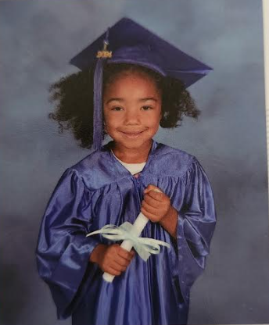
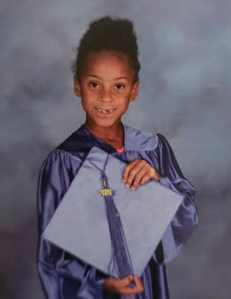
Bella and Maite Caquias
Bella and Maite are the children of Ms. Tee Robinson.
Bella is going to Kindergarten and Maite is promoted to the 1st grade
They both will be attending school in Columbia, SC.

Slide 5
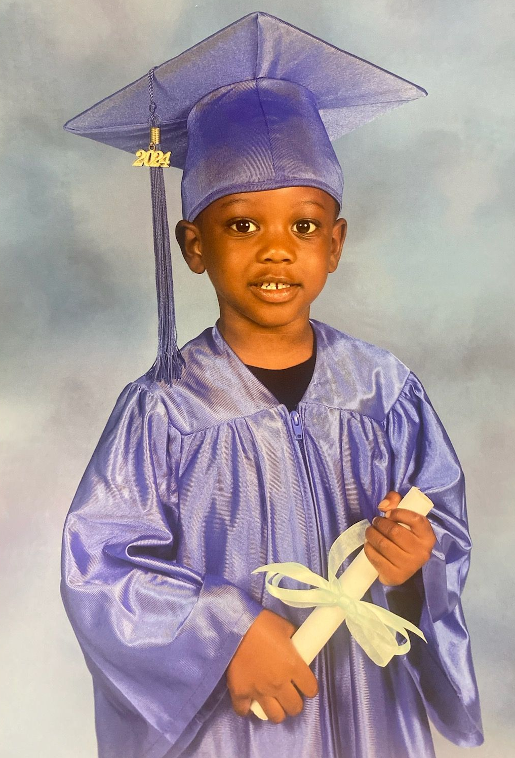
Kingston Frazier
(Parent: Tracey Brown)
Preschool Graduate
Angel Oak Elementary School

Slide 6
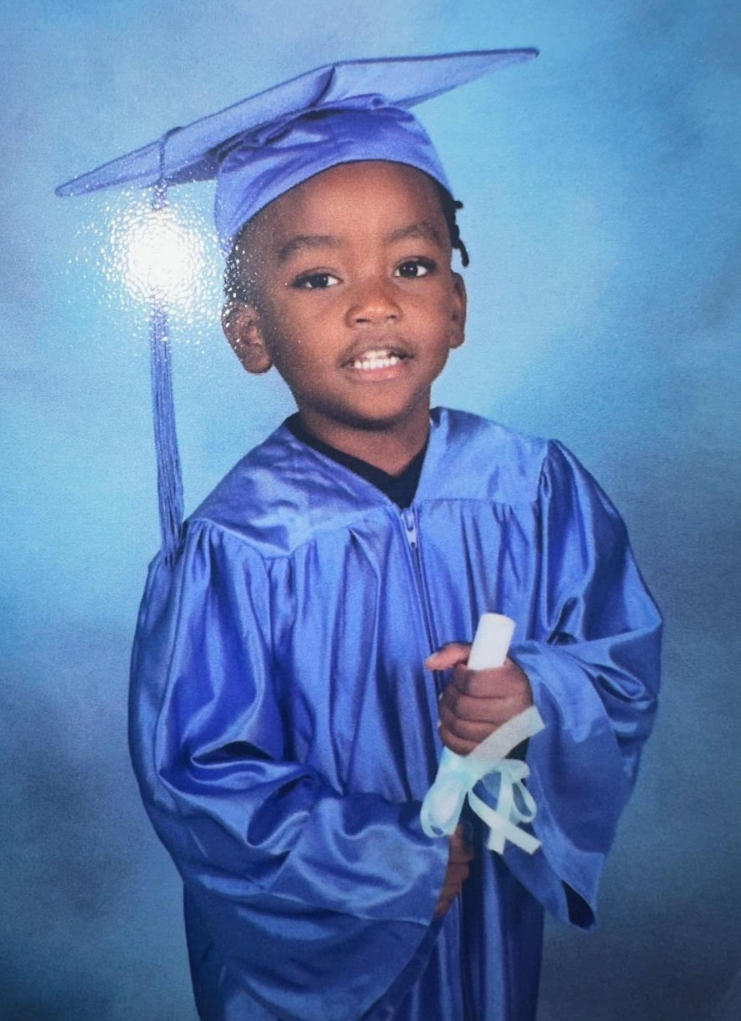
Kimani Pinckney
(Parent: Tyleah Legare)
Graduated Pre School from
Angel Oak Elementary

Slide 7
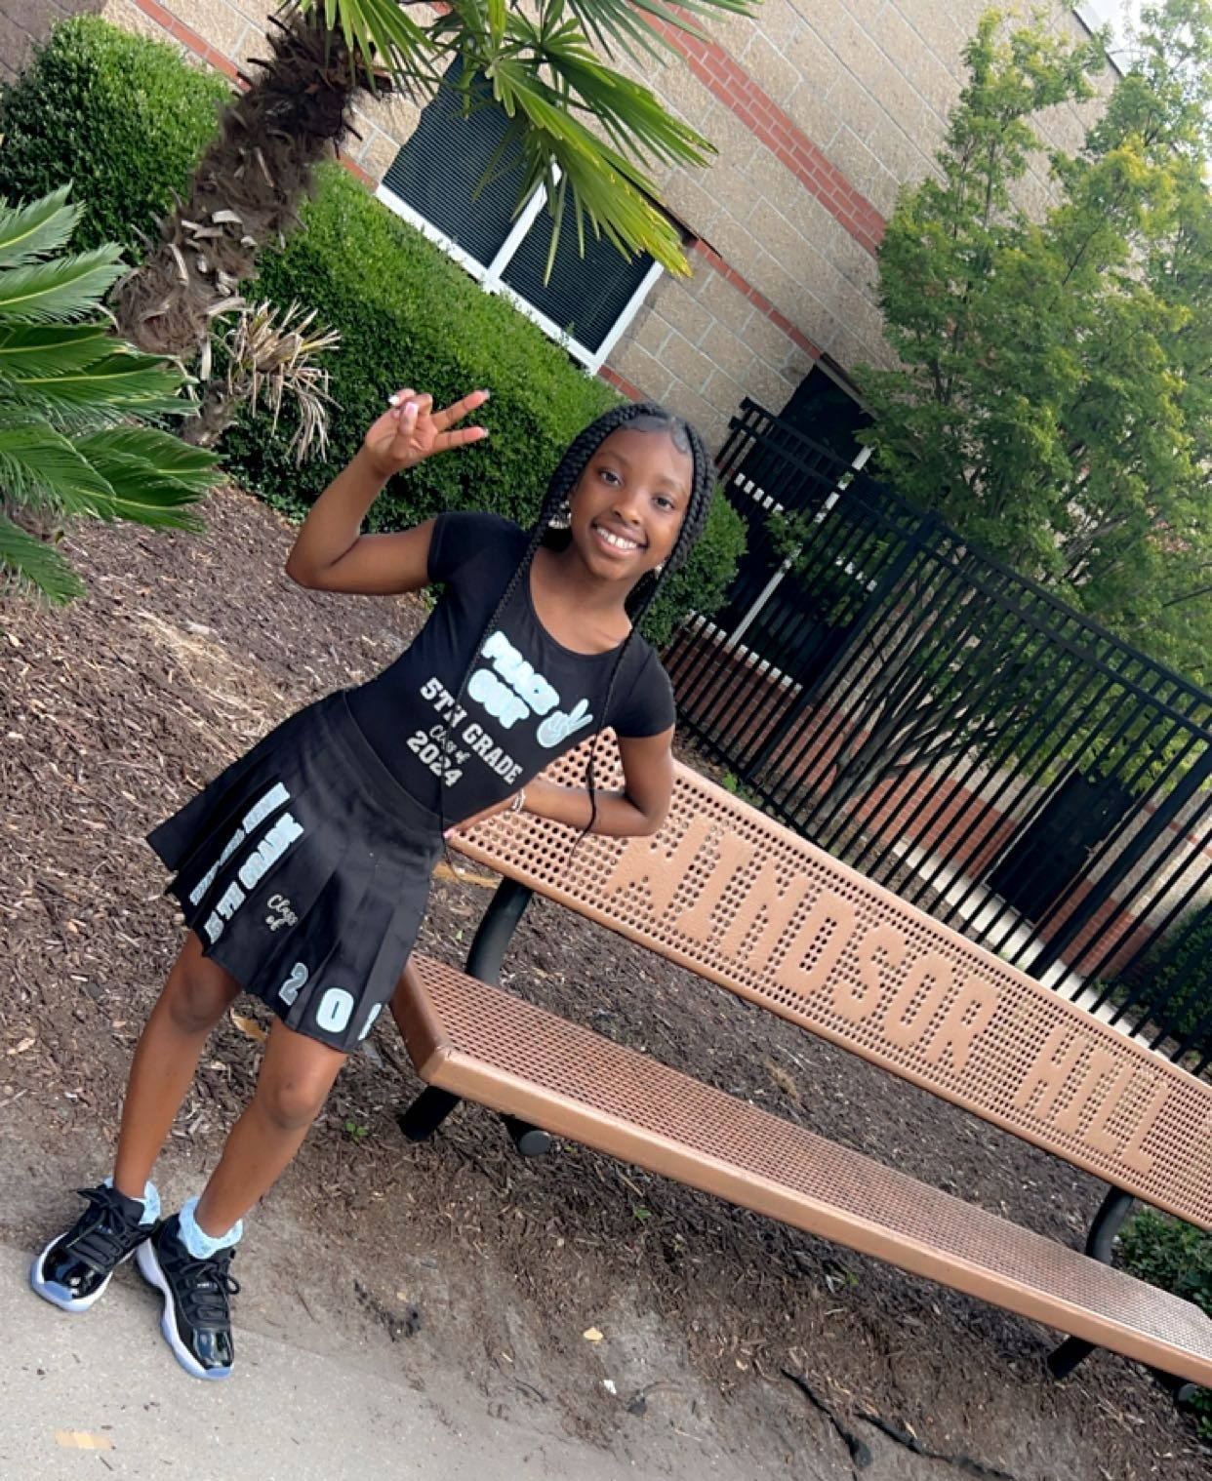
Mikenzi Coaxum
Daughter of Britany Sease
School Attending/Plans for Fall: River Oaks Middle
School Activities/Club: Dance, Drama
School-Awards: Gold Metal Award / A-Honor Roll every Semester
Hobbies: Majorette, Hanging out with friends and family

Slide 8
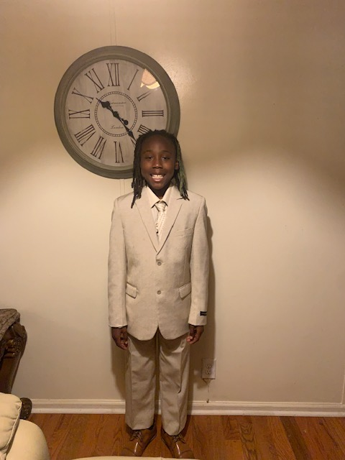
Gunner Washington
Gunner will be attending
Haut Gap Middle School.
He is the grandson of
Mrs. Beatrice Washington

Slide 9
Jailyn Roper
Jailyn will be attending Haut Gap Middle School.
She is the Daughter of
Colette M. Roper
Jailyn hobbies include making bracelets, annoying her brother, and doing hair (doll) and dancing (ballet).

Slide 10
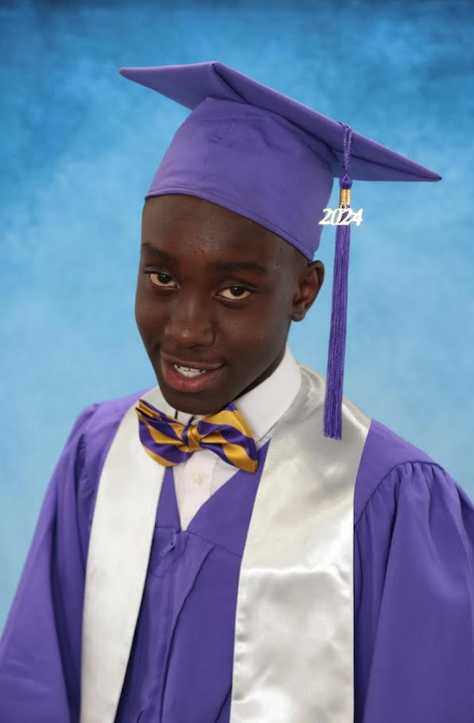
David Fitzgerald Brown, III
8th Grade Graduate
David is the great-grand son of Ruth Givens

Slide 11
Zyaire Carroll
Zyaire has graduated from Berkeley Middle School and is headed to Berkeley High School in Berkeley County.
He is the son of Timothy Lemon and the grandson of Shelly Smith.

Slide 12
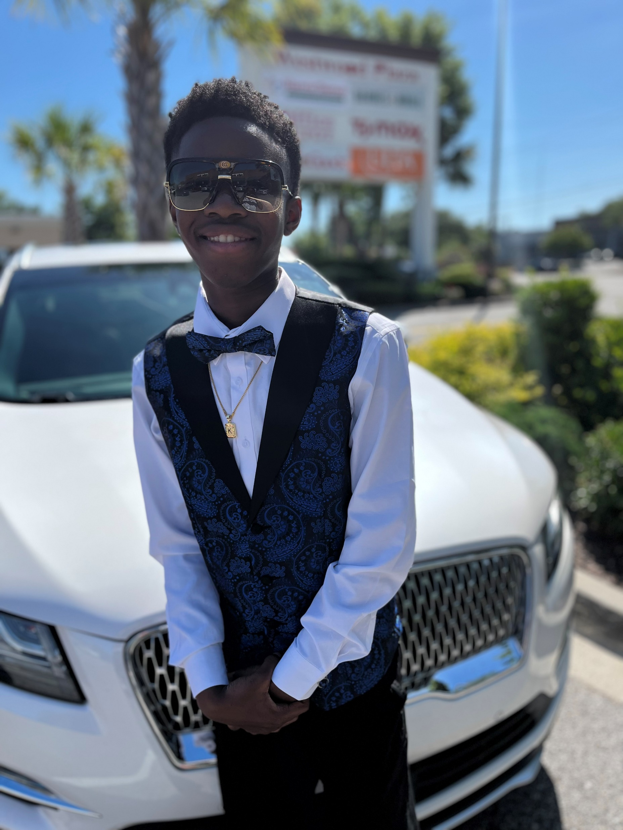
KaShawn Givens-Perry
KaShawn is the son of Kayla Givens
He will be attending St. Johns High School in the Fall.

Slide 13
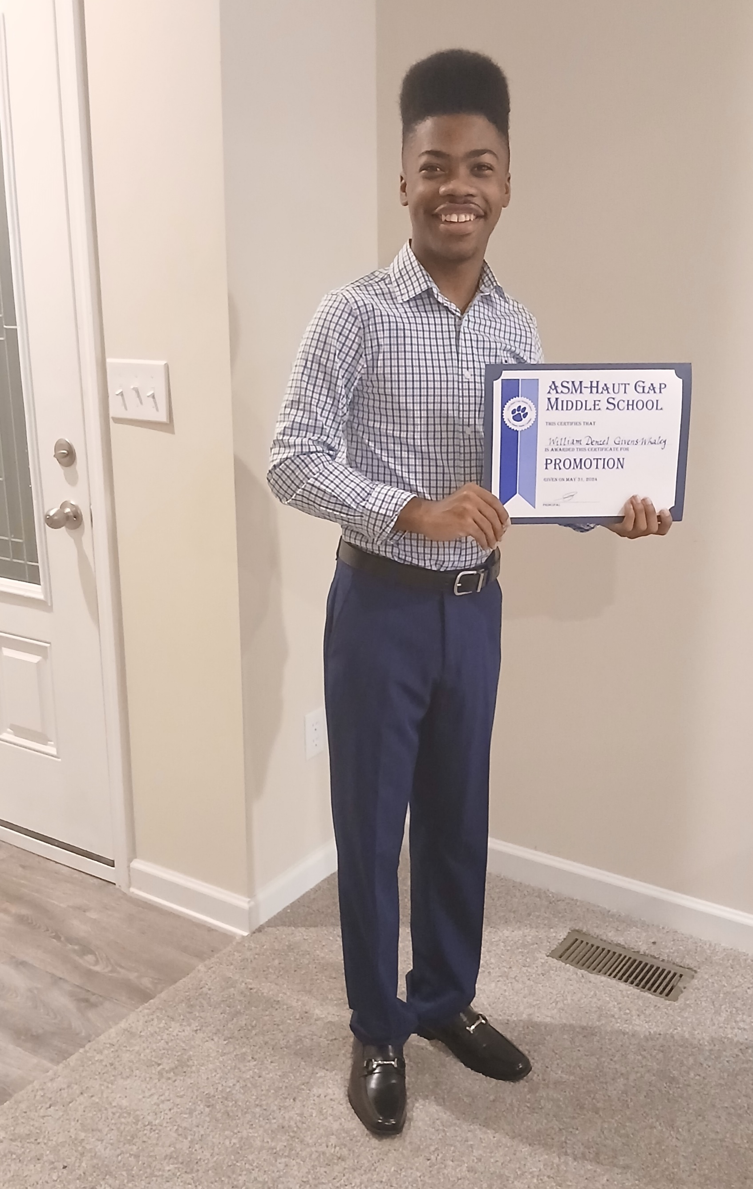
William Denzel Givens-Whaley
He will be attending St. Johns High School in the Fall.
His hobbies include Reading and Writing Fiction Stories
Denzel is the son of Leslie R. Givens

Slide 14
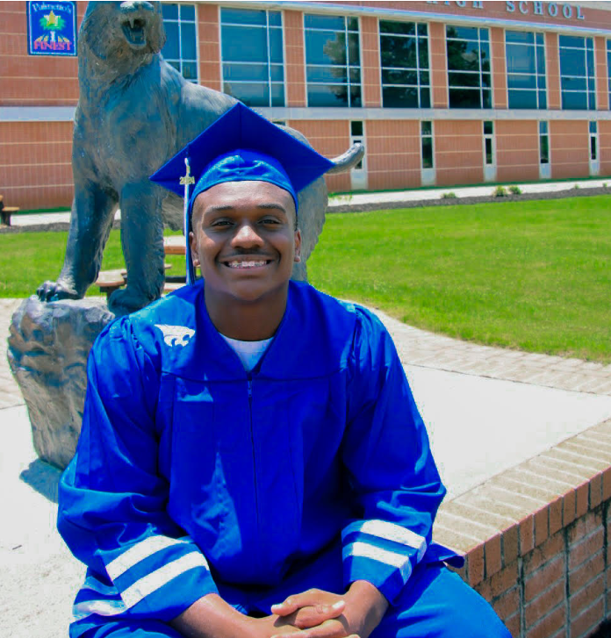
Reginald Broughton
Woodmont High School
Parent(s)/Guardian: Twanna & Reginald Broughton
School Attending/Plans For Fall: Anderson University
School Activities/Clubs: Football, basketball and Track
School Awards: 1st place 5A Region High Jump
Community Activities/Hobbies: Photography, thrifting

Slide 15
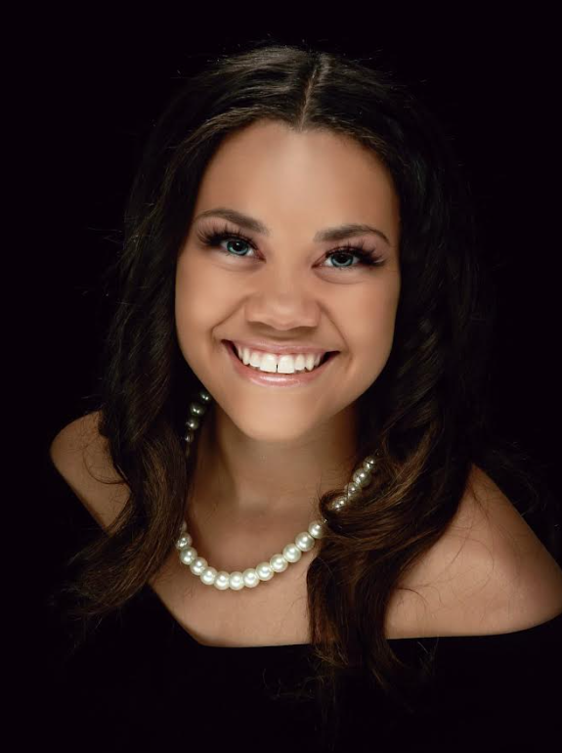
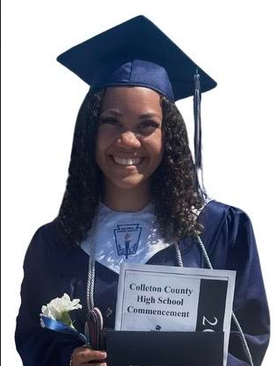
Aiyanna Souza
Aiyanna is a graduate of Colleton County High School. She is the daughter of Jason and Deandra Legare
Her Plans: Going to Coastal Carolina University
Her School Activities/Clubs included: Varsity Cheer, Track, National Honor Society
Her School Awards: Certified Nursing Assistant, Honor Students, Career and Technology Education Completer, National Technical Honor Society, National Honor Society
Hobbies: Cheer, Swimming, Reading, and Drawing

Slide 16
Tayla Legare Brown
A graduate of St. John’s High School
School Activities: Cheerleader, ROTC
Parents: Harlon & Wakeetha Renee Brown

Slide 17
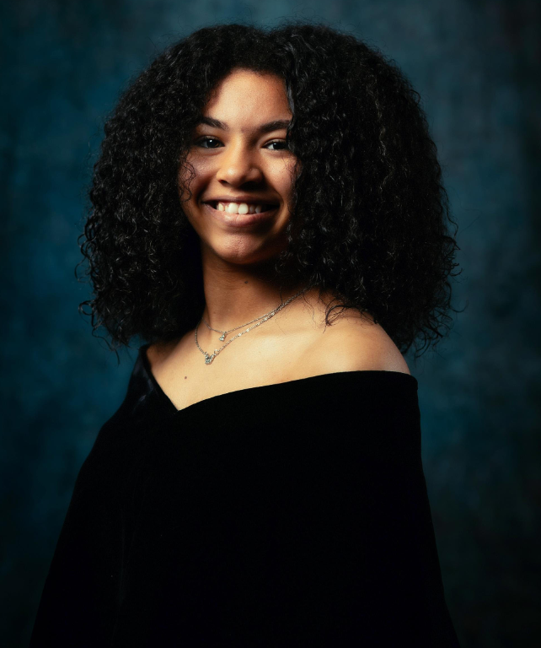
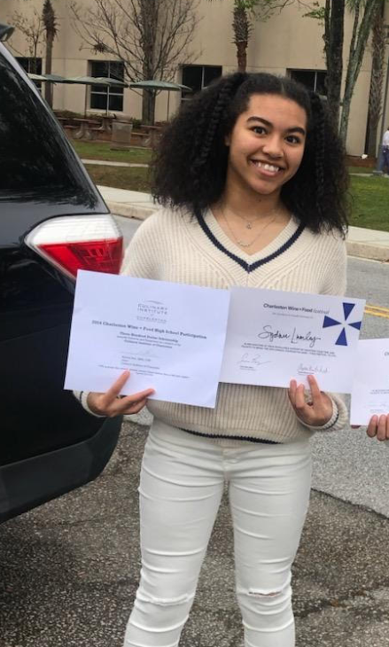
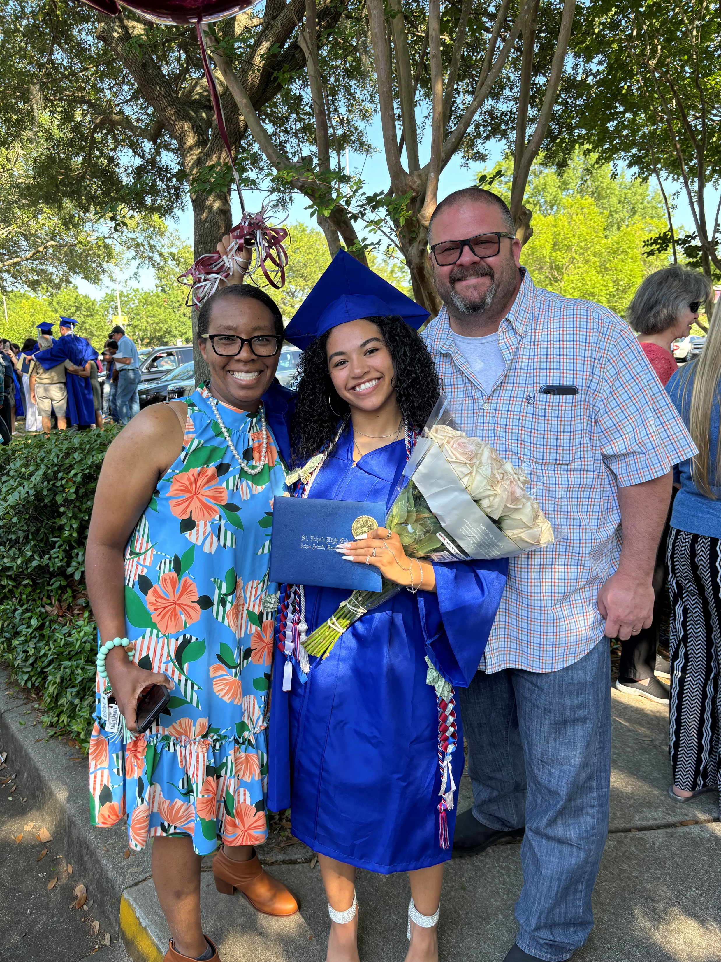
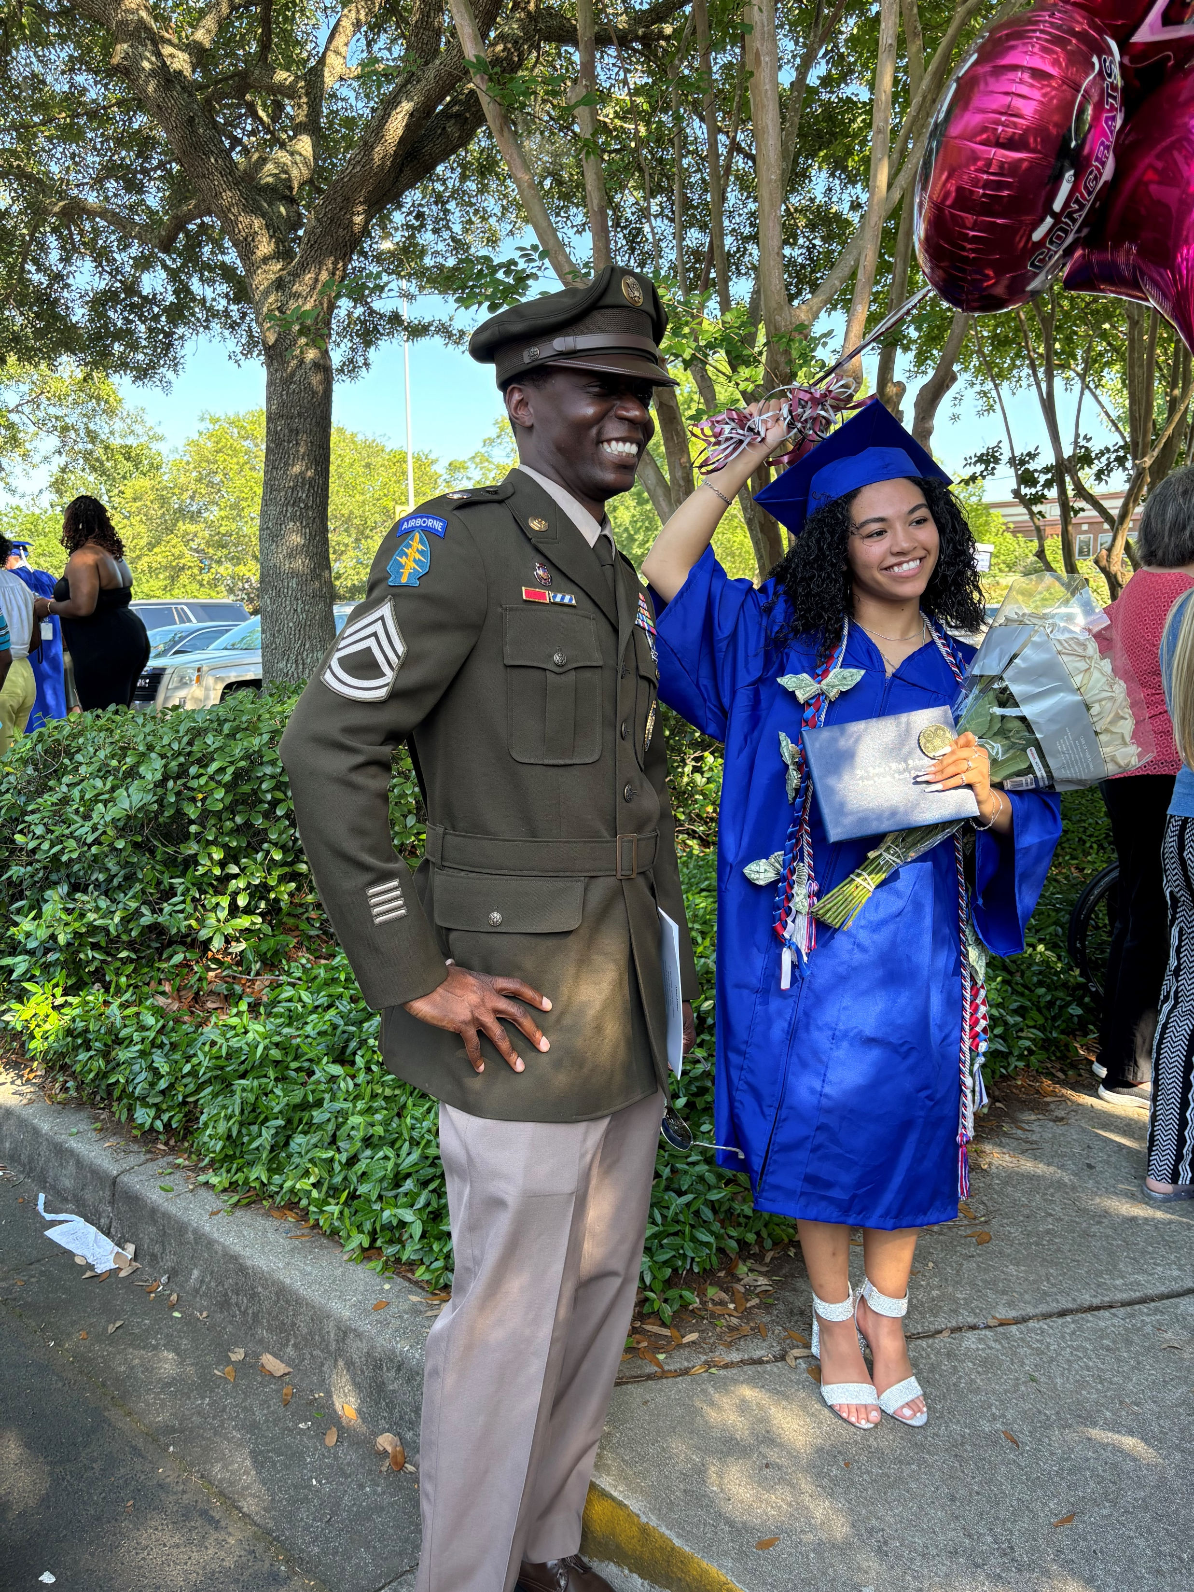
Shaynee Braxton Lumley
Parents Kristal and Kenneth Lumley, Grandparent Easter LaRoche
Graduated June 8th 2024 from St. Johns High School on John's Island.
Syd enjoys baking and cooking and received awards from various Culinary Competitions. She earned a Culinary Arts Completer award from Charleston County School District.
After High school, Sydnee will join the Army National Guard Reserves. She has further plans to attend college and pursue a degree in Psychology.

Slide 18
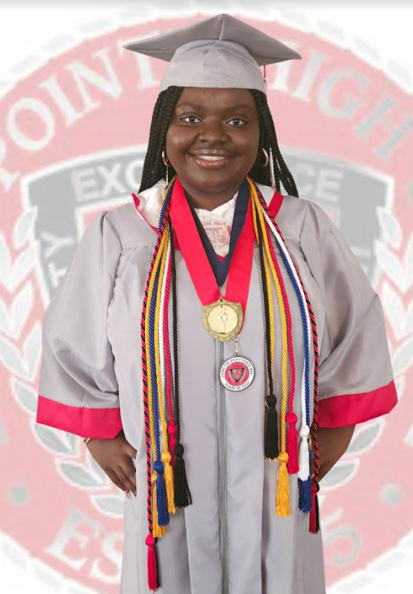
Corine Patterson
Graduate of South Pointe High School, Rock Hill, SC
Parent(s)/Guardian: Robertretta Brown(mother); Vernell Brown (grandmother)
School Attending/Plans For Fall: South Carolina State University, Major: Criminal Justice, Minor: English
School Activities/Clubs: Senior Class President, Student Council, National Honor Society, Beta Club
School Awards: Principal’s Leadership Award, Academic Excellence, South Carolina Department of
Education Seal of Distinction, Honor Roll, Principal’s List, On Pointe Scholar, College and Career Readiness
Community Activities/Hobbies: Miss Debutante 2nd Runner Up Eta Alpha Omega Chapter Alpha Kappa
Alpha Sorority, Inc., Competitive Dancing, and a Hostess at Texas Roadhouse

Slide 19
Samuel Washington
A graduate of Steel Valley Senior High School
Plans include: A four college

Slide 20
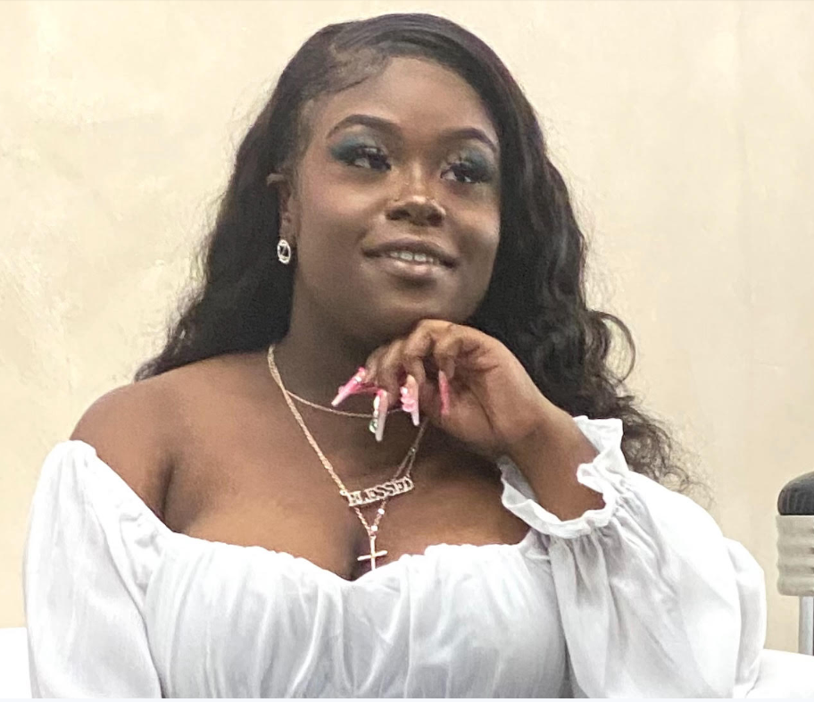
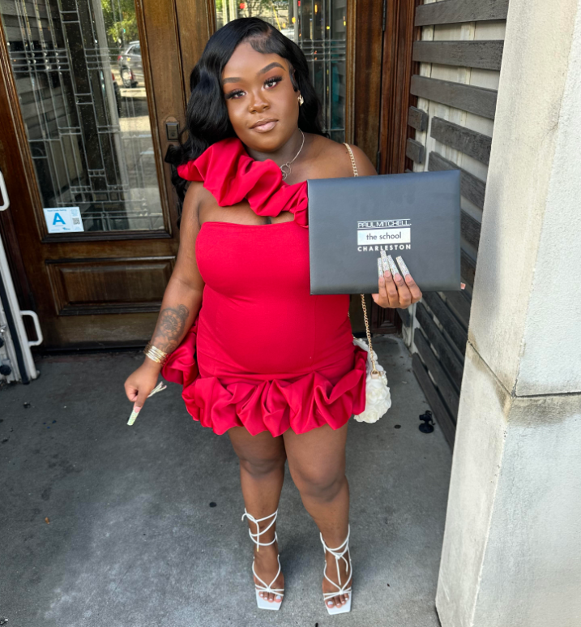
Zoe Scipio
A 2024 Graduate of
Paul Mitchell Cosmetology School
N. Charleston, SC
Daughter of April Brown-Cruz

Slide 21
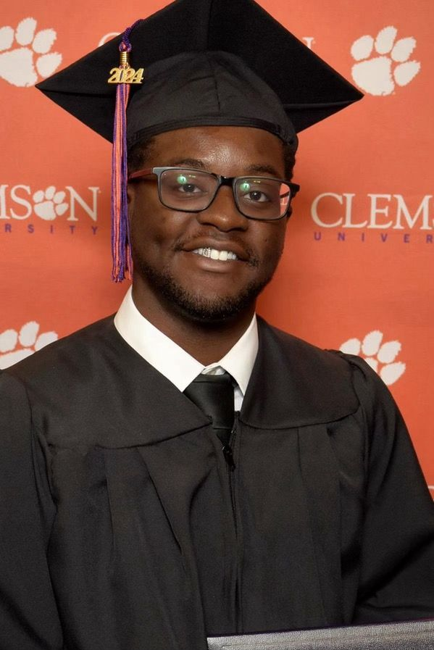
Jayvon Wright
Graduate of Clemson University
Major: Psychology
Grandparent: Elizabeth “Lizzy” Legare
Future Plans include: Grad School and the Marines

