Slide 1
Sunday, January 12 ,

Slide 2
Processional

Slide 3
Lighting of Candles
Greetings

Slide 4
Call to Worship…
LEADER: Be still for a moment. What do you hear? What do you smell? What do you feel under your feet? Beloved, God is here.

Slide 5
People: In the familiar and unfamiliar, God is here with us.

Slide 6
LEADER: Take a moment to look around. Whom do you notice? Who isn’t here that you expected to see? Whether this community feels brand new or familiar to you, God is here.

Slide 7
People: In the familiar and unfamiliar, God is here with us.

Slide 8
Leader: Take a deep breath. We share this air, this space, this worship home together. In our breathing and worshiping in the time and place, God is here.

Slide 9
People: In the familiar and unfamiliar, God is here with us.

Slide 10
Leader: God is here. May we pay attention and discern how God brings us together in the familiar and the unfamiliar to be and become the Body of Christ.

Slide 11
ALL: May we notice and join in God’s work of forming us for community as we worship today. AMEN!

Slide 12
Opening Hymn “My Hope is Built” #368

Slide 13
Morning Prayer

Slide 14
Response

Slide 15
Affirmation of Faith “The Apostles’ Creed”

Slide 16
I believe in God the Father Almighty. The maker of heaven and earth;

Slide 17
and in Jesus Christ his only Son our Lord: who was conceived by the Holy Spirit, born of the Virgin Mary,

Slide 18
suffered under Pontius Pilate, was crucified, dead, and buried;

Slide 19
the third day he rose from the dead; he ascended into heaven,

Slide 20
and sitteth at the right hand of God the Father Almighty; from thence he shall come to judge the quick and the dead.

Slide 21
I believe in the Holy Spirit, the Holy catholic** church, the communion of saints, the forgiveness of sins,
**Church Universal

Slide 22
the resurrection of the body, and the life everlasting. Amen.

Slide 23
Gloria Patri
Glory be to the Father, and to the Son and to the Holy Ghost,

Slide 24
as it was in the beginning, is now, and ever shall be, world with-out end.
A-men. A-men

Slide 25
The Offering (It’s Giving Time) “Praise God, from whom all blessings flow; praise him, all creatures here below; praise him above, ye heavenly host; praise Father Son, and Holy Ghost, Amen”

Slide 26
*The Dedication of Tithes and Offering
UMH #588 “All things come of thee, O Lord, and of thine own have we given thee.” AMEN!

Slide 27
Parish Notices/Recognition of Visitors

Slide 28
WE Listen for God’s Word

Slide 29
Proclamation and Response/We Listen for God’s Word
Old Testament: Isaiah 62: 1-5
New Testament: John 2: 1-11
Leader: The Word of God for the people of God.
People: Thanks be to God.

Slide 30
Selection Wesley’s Ensemble

Slide 31
The Message by
Rev. Doris Bright, Pastor

Slide 32
Invitational /
Altar Call

Slide 33
Extinguishing of the Candles

Slide 36
Finance Committee

Slide 37
WUMC Financial Presentation
The Finance Committee

Slide 38
AGENDA
Introduction
Primary goals
Financial data
Timeline
Fundraisers
Summary

Slide 39
INTRODUCTION
This brief overview is to display Wesley’s financial state from 2024. The Finance Committee will continue to be transparent with the finances and show the importance of the members’ support is vital to continue building Wesley for years to come!

Slide 40
PRIMARY GOALS
Display overall financial state for 2024

Slide 41
a minimum of 7,500 weekly and 30K monthly is needed to support NORMAL operating COSTS

Slide 42
Annual church INCOME & expenses

Slide 43
Noteworthy for 2024!!
$29,853
Fundraising Efforts
Capital expenses
$94,330(incl Rental property repair)
Mortgage balance
$851,269 as of 12.31.24
Income
CS&T decreased by 70K

Slide 44
2024 EXPENSES
Operating Expenses
256,857
Salaries & Benefits
101,334(P); 26,564(M)
Ministries
12,681
90,136 - Mortgage
38,594 - Utilities
128,127 - Trustees
69,219 - Pastor (salary, continuing education, & mileage)
32,115 - Fringe benefits
(5,050.00 – Accountable Reimbursement-illustration only)
26,564 - Musicians
3,875 – Nurture
2,521 – Outreach
6,285 – Miscellaneous Expenses

Slide 45
2024 accomplishments
Extra principal payment made of $14,400
$16,170 set aside from fundraising efforts for the building fund
$12,000 saved from rental property income
Total collected for the building fund=$28,170

Slide 46
2025 fundraising efforts
Q1
Superbowl Sunday. Contributions will be announced by the end of February
156th Church Anniversary
Q4
Ongoing Efforts
Building Fund
Ongoing Efforts
The Finance Committee focus for this year is paying off the mortgage with a goal by 2028!

Slide 47
SUMMARY
The Finance team remains committed to its efforts to focus on the elimination of Wesley’s mortgage and updating the congregation annually. All members are encouraged to inquire with any member of Finance about any questions or concerns they may have.

Slide 48
THANK YOU
FOR SUPPORTING WESLEY AND ALL THAT EACH OF YOU DO TO THE BUILDING OF ITS KINGDOM!
Deuteronomy 14:22

Slide 49
Trustee Committee

Slide 50
BOARD OF TRUSTEES COMPLETED THE REPAIRS AND
UPGRADE AT PARSONAGE 2023-2024
1. Repaired foundation (sills, bands and removed all particle board)
2. Installed pump to crawlspace to decrease water and moisture under parsonage
3. Installed security cameras
4. Fully renovated both full bathrooms at parsonage
5. Trim oak trees to decrease roof damage

Slide 51
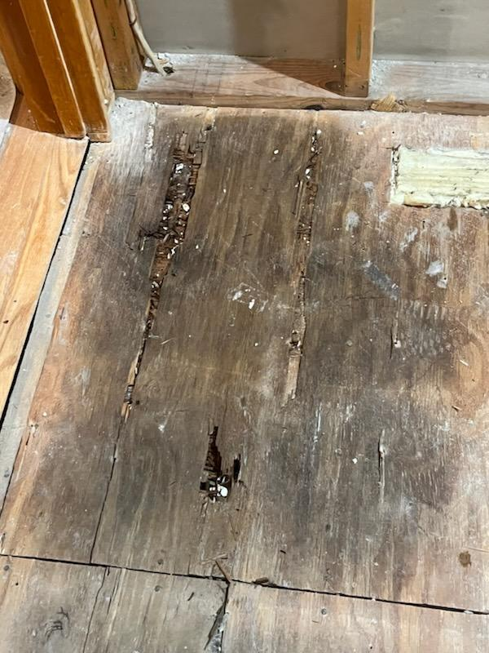
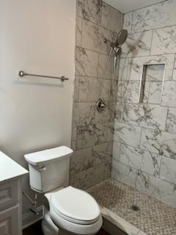

Slide 52
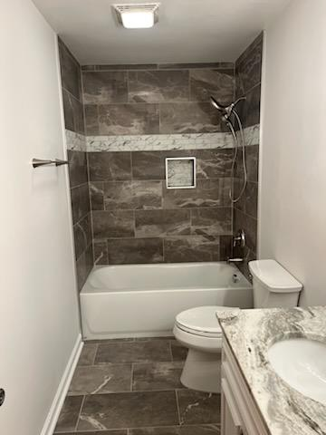
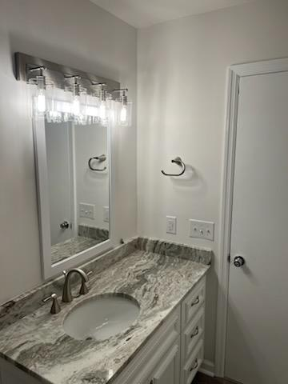

Slide 53
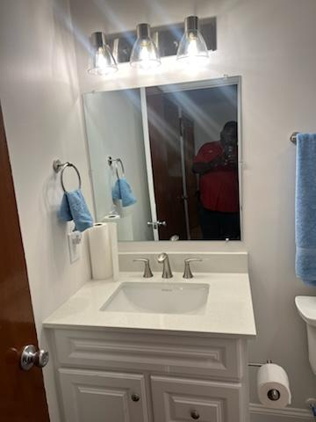
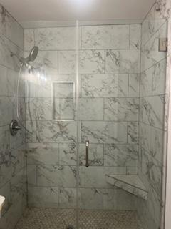

Slide 54
1. Repaired longstanding leak in Board Room which includes:
a. Repairing roof
b. Removing and replacing sheetrock, light
fixtures, painting, etc
c. Replaced HVAC System
d. Replaced flooring
e. Repaired windows
2. Repaired Foyer
3. Repaired storage room

Slide 55
4. Painted foyer and hallway
5. Repaired HVAC system in office and pastor’s office
6. Replaced HVAC system in Classroom
7. Purchased Mini IPAD and headset
8. Removed and replaced fencing around HVAC

Slide 56
ONGOING AND UPCOMING PROPOSED REPAIRS and UPGRADES TO FELLOWSHIP HALL AND GROUNDS
1. Paint outside of entire Fellowship Hall
2. Replace fencing around kitchen

Slide 57
3. Continue to upgrade and replace Audio Visual equipment
4. Construct a covering for Bus
5. Continue working on barriers around graveyard

